Slide 1
Pharmacokinetics of analgesics, sedatives, and antipsychotics in critically ill patients
Shawn Whitehead PharmD, BCCCP
Pharmacy Clinical Specialist – TICU / Burn

Slide 2
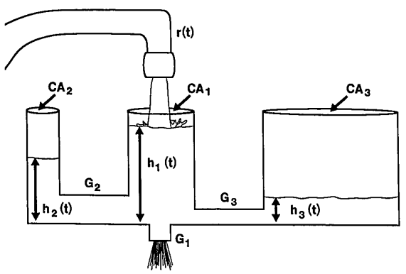
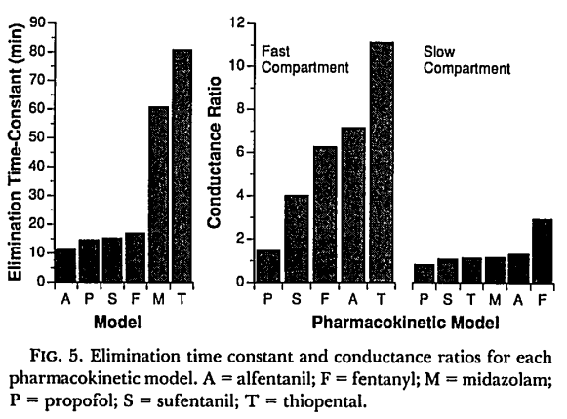

Fentanyl
3 Compartment Model
Analgesic and sedative effects
Highly lipophilic
Fast onset of action
Obesity → ↑ Volume of distribution
Distributes to peripheral tissues → accumulation with longer duration of infusion → ↑ T_{1/2}
Age not significant factor in fentanyl metabolism
Notes:
3 compartment model
The size of the compartments and the speed with which fluid flows between dictates the central compartment serum concentration

Slide 3
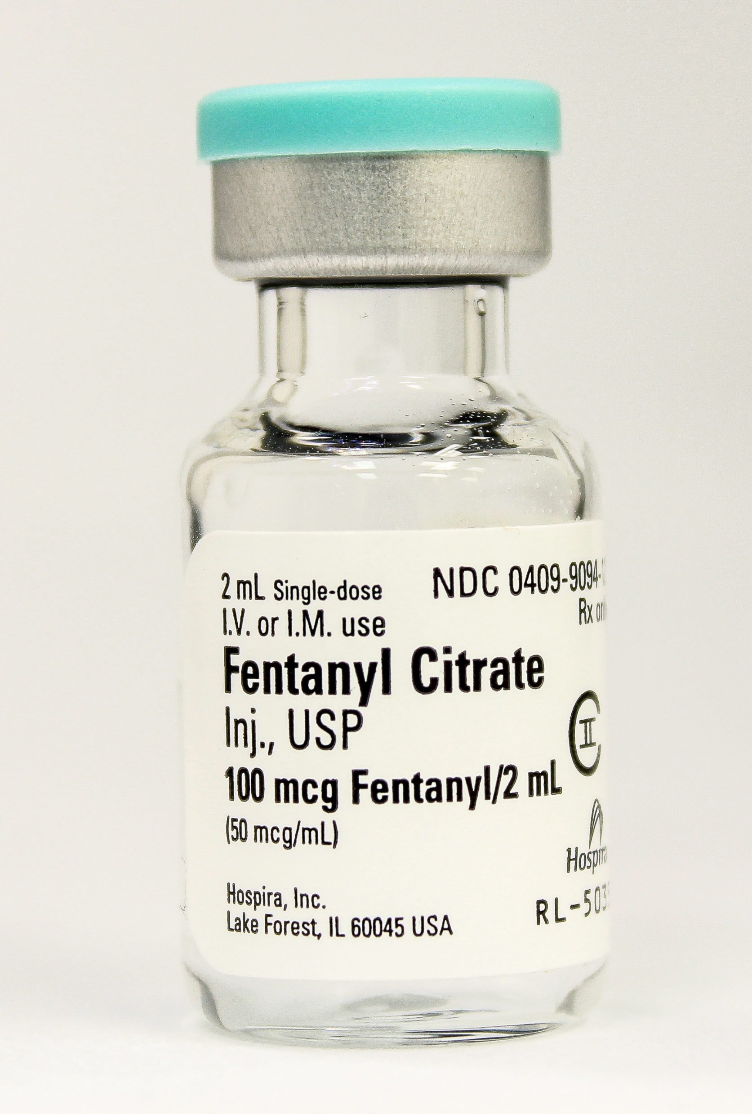
Factors causing decreased clearance
↓ patient weight
After 1 day of 100 mcg/hr:
Plasma concentrations 50% higher in patients at 10% percentile of weight vs. 90% percentile
History of severe liver disease
Extensively hepatically metabolized with high hepatic extraction ratio
CHF
reduction in hepatic blood flow → ↓ metabolism
Crit Care Med 2016; 44:64–72

Slide 4
Choosing an Opioid
Most balanced = oxycodone
Onset: 15 minutes
Peak effect: 30 – 60 minutes
Less histamine release
Duration of action: 4-6 hrs
Consider dosage reductions renal impairment
Half life prolonged 1 hour with CrCl <60 mL/min
Peak concentrations and AUC increased by ~50%
Safest Option = hydromorphone
Least histamine release
No opioid active metabolites
Preferable in renal impairment or hemodynamic instability
IV
Onset of action: 5 minutes
Peak effect: 10 – 20 minutes
PO:
Onset of action: 15 - 30 minutes
Peak effect: 30 – 60 minutes
Duration of action: 3 – 4 hours

Slide 5
Equivalent Analgesic Dosing
Opioid | IV | Oral
Codeine | 120 mg | 200 mg
Fentanyl | 0.1 mg (100 mcg) | N/A
Hydrocodone | N/A | 30 mg
Hydromorphone | 1.5 mg | 7.5 mg
Methadone | Ask your Pharmacist
Morphine | 10 mg | 30 mg
Oxycodone | N/A | 20 mg
Tolerance to one opioid does not mean tolerance to all opioids
When converting from one to another, decrease dose ~25-50%
Notes:
Opioid hyperalgesia → increased sensitivity to pain and opioids can paradoxically worsen pain in conjunction with increasing opioid tolerance

Slide 6
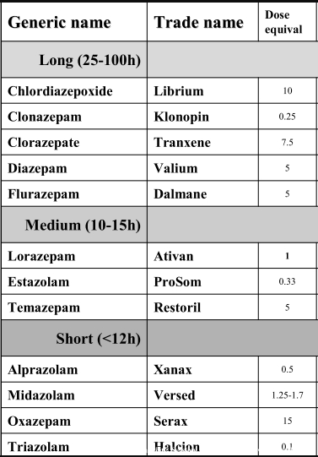
Benzodiazepines
Anxiolytic, amnestic, sedating, hypnotic, and anticonvulsant effects
Midazolam and diazepam are lipid soluble
↑ onset of sedation
Larger volume of distribution
Lorazepam is more hydrophilic
Potency
Lorazepam > Midazolam > Diazepam

Slide 7
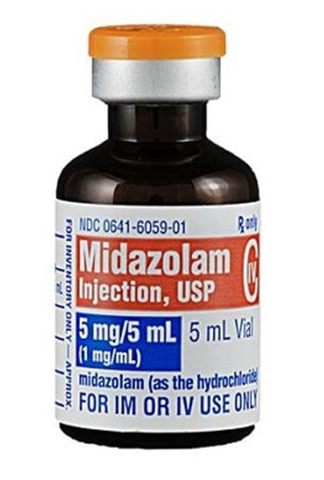
Midazolam
Lipophilic
Bioavailability
Intranasal: 60%
Rectal: 50%
97% protein bound (mostly albumin)
Extensively metabolized by CYP3A4 to 3 metabolites (1 active)
Active metabolite: α1–hydroxy-midazolam
80% potency of midazolam
T_{1/2}: 1 hour in normal renal function
Renally cleared after glucuronidation in liver
Notes:
Increased volume of distribution from critical illness prolongs half life

Slide 8
Midazolam half-life variability
Half life prolonged in:
Hepatic dysfunction
Intermediate to high extraction drug during hepatic metabolism
Any factor ↓ hepatic blood flow → prolonged T_{1/2}
Obesity
Depot formation in the peripheral tissue
↑ adipose tissue → accumulation of drug and metabolite
Elderly
↑↑ Inflammation
CRP ≥ 300 mg/L → 65% lower clearance compared to CRP of 10 mg/L
Critically ill patients → extremely variable T_{1/2}: 2.2 – 35.5 hours
Notes:
Elderly due to decreased function of CYP enzymes with age
2 compartment model

Slide 9
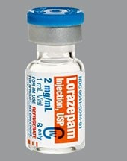
Lorazepam
Dose Adjustment: Renal & Hepatic dysfunction
Rapidly hepatically conjugated to lorazepam glucuronide (inactive)
Hydrophilic
Onset of action:
IV: 15 – 20 minutes
Oral: 20 – 30 minutes
T_{1/2}: 8 – 15 hours
Bioavailability: 90%
Propylene glycol toxicity
Metabolic acidosis and AKI
Total daily IV doses as low as: 1mg/kg
Consider monitoring osmole gap (goal: <10 mOsm)
Notes:
Why do you think lorazepam’s onset of action is slower?

Slide 10
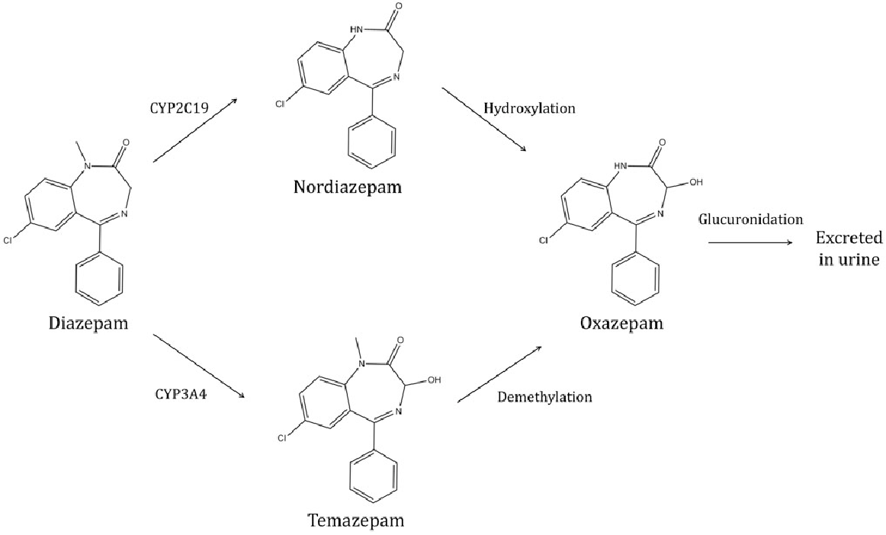
Diazepam
Highly lipophilic
Rectal and oral bioavailability: 90% +
Diazepam > temazepam + desmethyldiazepam > oxazepam
T1/2
Parent: 40 h
Desmethyldiazepam: 160 h

Slide 11
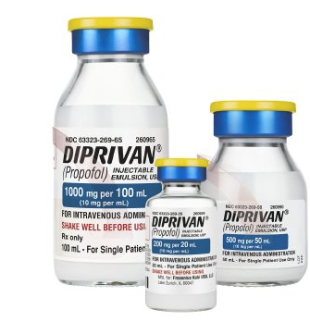
Propofol
Sedative, hypnotic, anxiolytic, amnestic, antiemetic, and anticonvulsant properties
No analgesic effects
Highly lipid soluble
Rapid onset of action
Rapid offset of effect following short term use
Useful in patients requiring frequent awakenings
Neurological assessments
Daily sedation interruption

Slide 12
Propofol
↑ Total exposure is associated with delayed emergence 2/2 saturation of peripheral tissues
Cumulative dose = length of exposure X rate of administration
Respiratory depression
Hypotension 2/2 systemic vasodilation
10% lipid emulsion
Hypertriglyceridemia
Pancreatitis
Egg or soybean allergies
Notes:
Respiratory depression:
Markedly reduces TV and somewhat reduces RR
Amnestic effects at light levels of sedation are less than benzodiazepines
TGs: consider switching with ~500 mg/dL

Slide 13
Propofol Infusion Syndrome (PRIS)
Incidence is rare (~1%)
Mortality rate up to 33%
Proposed mechanisms
Mitochondrial dysfunction
Impaired fatty acid oxidation
Diversion of carbohydrate metabolism to fat substrates
Metabolite accumulation
Associated with high doses (> 70 mcg/kg/min) and prolonged infusions (> 48 hours)
Definition:
Metabolic acidosis + cardiac dysfunction and 1 of:
Rhabdomyolysis
Renal failure
Hypertriglyceridemia
Devlin JW et al. Crit Care Med. (2018)
Barr J et al. Crit Care Med. (2013)
Roberts RJ et al. Crit Care. 2009;13(5):R169. doi:10.1186/cc8145
Notes:
cardiac dysfunction that included a Brugada-like ECG pattern, asystole, pulseless electrical activity, ventricular fibrillation, sustained ventricular tachycardia of 30 seconds or longer, myocardial failure (ejection fraction ≤ 40%), or bradycardia (heart rate ≤ 50 bpm not felt to be related to a medication other than propofol)
Renal failure that included oliguria (urine output ≤ 0.5 mL/kg/hr for ≥ 6 hours), anuria (urine output ≤ 10 mL/hr for ≥ 6 hours), elevation in serum creatinine (increase of ≥ 1 mg/dL from baseline), or hyperkalemia (serum K⁺ ≥ 6 mg/dL (excluding other known causes or hemolyzed specimens))

Slide 14
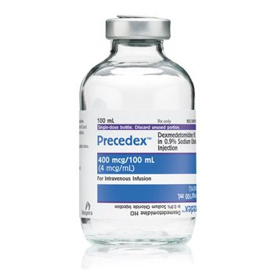
Dexmedetomidine
Sedative, analgesic/opioid sparing, sympatholytic properties
↑ Ease of arousal
Minimal respiratory depression
Onset of sedation: 15 min
Peak sedation: <1 hr after starting drip
ADEs:
Bradycardia
Hypotension
Abrupt withdrawal can cause rebound HTN and ↑ HR

Slide 15
Dexmedetomidine
No anticonvulsant effects
Only achieves minimal to moderate sedation
Not appropriate for NMBA
Loading dose associated with significant hypotension and bradycardia
Reduced clearance with severe hepatic dysfunction
Can be used in non-intubated patients and patients after they have been extubated

Slide 16
Sedative Properties
 | Benzodiazepines | Propofol | Dexmedetomidine
Anxiolytic | + | + | +
Amnestic | + | +
Hypnotic | + | +
Anticonvulsant | + | +
Analgesic |  |  | +

Slide 17
 | MENDS (2007) | MIDEX/PRODEX (2012) | SEDCOM (2009)
Purpose | Compare duration of delirium and coma in mechanically ventilated patients with dexmedetomidine vs lorazepam | Determine efficacy of dexmedetomidine vs midazolam or propofol | Compare efficacy and safety of prolonged sedation with demedetomidine vs midazolam in mechanically ventilated patients
Methods | Double blind, randomized controlled trial Medical/surgical ICU patients requiring mechanical ventilation > 24 hours | Two phase 3 multicenter, randomized, double blind controlled trials Mechanically ventilated ICU patients | Prospective, randomized, double blind controlled trial Mechanically ventilated ICU patients
Outcomes | Primary: delirium and coma free days Secondary: ICU/Hospital LOS, 28 day mortality, ventilator days | Primary: time at target sedation (RASS 0 to -3), duration of mechanical ventilation Secondary: ICU LOS, time to extubation, arousabillity of patient | Primary: percentage of time within target RASS (+1 to -2) Secondary: delirium free days, time to extubation, ICU LOS, 30 day morality
Results | Demedetomidine group had more delirium and coma free days (7 vs 3) No difference in secondary outcomes or safety endpoints | No difference in primary outcome Shorter duration of mechanical ventilation and shorter time to extubation in dexmedetomidine groups | No difference in primary outcome Dexmedetomidine group had 30% less delirium and spent ~ 2 fewer days on the ventilator
Conclusions | Dexmedetomidine resulted in more days alive without delirium or coma and more time at the targeted level of sedation | Dexmedetomidine group had shorter time to extubation, able to communicate with nursing staff, no difference in ICU/hospital LOS | Dexmedetomidine group had less time on the ventilator, less delirium, and developed less tachycardia and hypertension
Pandharpande PP, et al. JAMA (2007).
Riker RR, et al. JAMA (2009).
Jakob SM, et al. JAMA (2012).

Slide 18
Non-Benzodiazepine Sedation
Propofol and dexmedetomidine may be preferred over sedation with benzos
↓ ICU length of stay by 0.5 days
↓ Length of mechanical ventilation
SEDCOM
Time to extubation: dexmedetomidine: 3.7 days vs. Midazolam: 5.6 days
No difference in incidence of self-extubation
Carson et al.
Intermittent lorazepam vs. propofol in patients on MV for ≥48h
Median ventilator days: Propofol: 5.8d vs. Lorazepam: 8.4d; P=0.04
No difference in mortality
Benzodiazepines remain important
Anxiety
Seizures
Benzo withdrawal
Deep sedation
Amnesia
Notes:
Decreased ICU length of stay is meta-analysis of 6 trials of moderate to high quality
Alcohol withdrawal → phenobarbital

Slide 19
Agent | Onset after loading dose | T_{1/2} | Loading Dose (IV) | Maintenance Dose (IV) | Adverse Effects
Propofol | 1-2 min | Short term use: 3-12hr Long-term use: 50 ± 18.6hr | 5mg over 5 min¹ | 5-50 mg/kg/min | Pain on injection, hypotension, respiratory depression, ↑TGs, pancreatitis
Lorazepam | 15-20 min | 8-15hr | 0.02-0.04 mg/kg (≤2mg) | Bolus: 0.02-0.06 mg/kg q2-6h prn Continuous: 0.01-0.1mg/kg/hr | Respiratory depression, hypotension, propylene glycol acidosis, nephrotoxicity
Precedex | 5-10 min | 1.8-3.1 hr | 1mg/kg over 10 minutes | 0.2-0 1.5 mg/kg/hr | Bradycardia, hypotension, hypertension w/ loading dose, loss of airway reflexes
Midazolam | 2-5 min | 3- >24 hr | 0.01-0.05 mg/kg over several min | 0.02-0.1 mg/kg/hr | Respiratory depression and hypotension
Notes:
Propofol
Administer IV loading dose only in those patients in whom hypotension is unlikely to occur
Pain generally occurs when propofol is administered through peripheral IVs
Deep sedation with propofol is associated with significantly longer emergence times than lighter sedation
Precedex:
Avoid dexmedetomidine loading doses in hemodynamically unstable patients 2/2 hypotension and bradycardia
Doses up to 1.5mg/kg/hr have been used safely if tolerated by patient

Slide 20
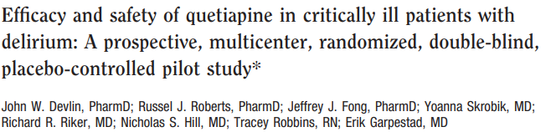
Treatment of delirium
Quetiapine + prn haloperidol
Quetiapine group received 50mg q12h increasing q24h if ≥1 dose of prn haldol was used
Haldol 1-10mg IV up to q2h prn to control symptoms associated with delirium
↓ Time to first resolution of delirium
Quetiapine: 1d, Placebo: 4.5d; P=0.001
↓ Time in delirium (hours)
Quetiapine: 36, Placebo: 120, P=0.006
Devlin JW et al. Crit Care Med. 2010 Feb;38(2):419-27.

Slide 21
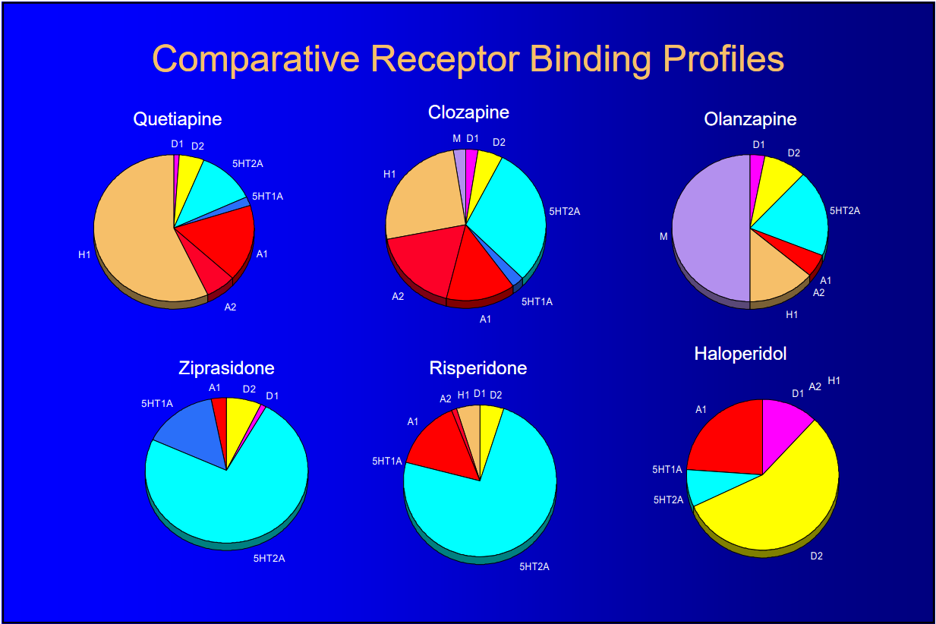
Antipsychotic receptor antagonism

Slide 22
Antipsychotics
Haloperidol
VERY Limited evidence for reduction of duration of delirium as monotherapy
Repeat dose until agitation subsides
Some data to suggest QTc prolongation risk increased in patients with NORMAL baseline QTc
Olanzapine
40% increase in clearance in smokers, 30% decrease in clearance in females
Risperidone and haloperidol have similar potency (mg/d)
Notes:
Olanzapine: MOA: 5-HT2A, 5-HT2C, dopamine D1-4, histamine H1, alpha1- adrenergic receptors, weak GABA-A, BZD

Slide 23
Agent | Dose | T_{1/2} | Dosage Adj. | Sedation | QTc | Lipid/ DM
Haloperidol (IV/PO/IM) | 2-5mg IV, then repeat doubling dose q15min* | 18h Onset (IV): 3-20min Peak (IV): 30 mins | Renal: No Hepatic: No | Low | Moderate (IV >> PO) | Low
Quetiapine (PO) | 50mg q12h titrating by 50mg q12h daily based on prn usage | 6-7h Metabolite: 9-12h | Renal: No Hepatic: Yes, ↓30% | Moderate | Moderate | Low-Moderate
Olanzapine (PO/SL/IM) | PO: 5mg QD to BID, IM: 5x > plasma conc. vs. IV | 21-54h ~1.5x in elderly | Renal: No Hepatic: Yes (monitor) | Moderate | Low | High

Slide 24

Role for Antipsychotics in ICU
Acutely Uncontrolled Agitation
Difficult to sedate patient
Sedative antihistaminergic effect
Anxiolysis
Watch for akathisia from antidopaminergic properties
Insomnia

Slide 25
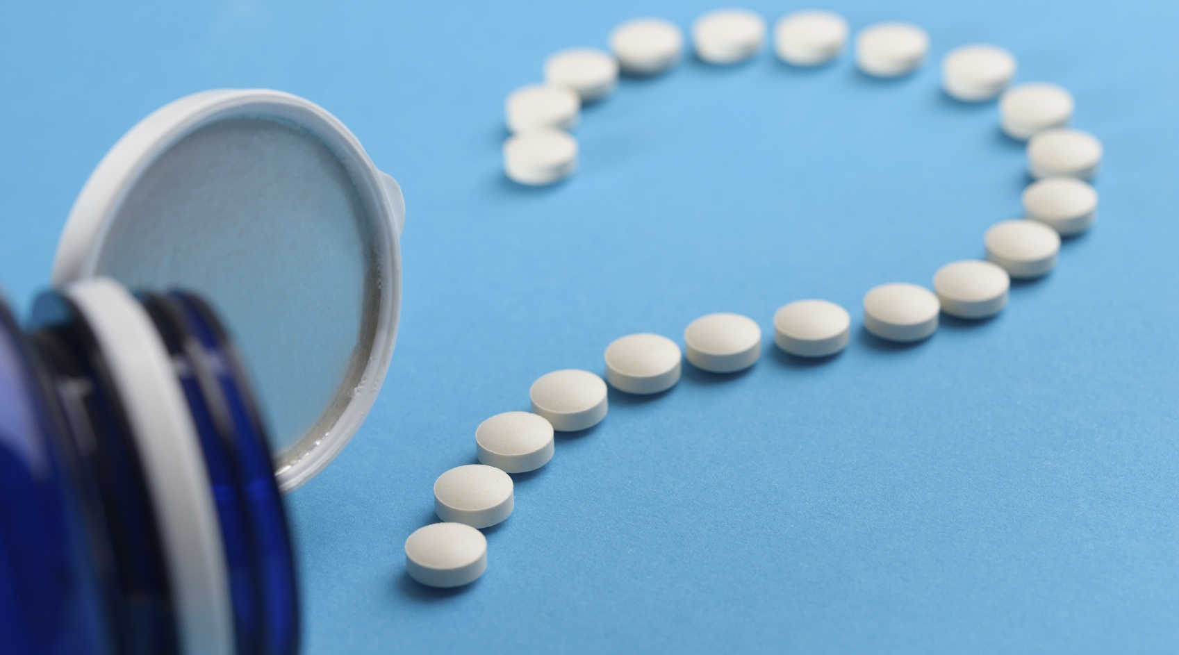
Questions?
Shawn Whitehead
Email: Swhitehead@lifespan.org

